Slide 1
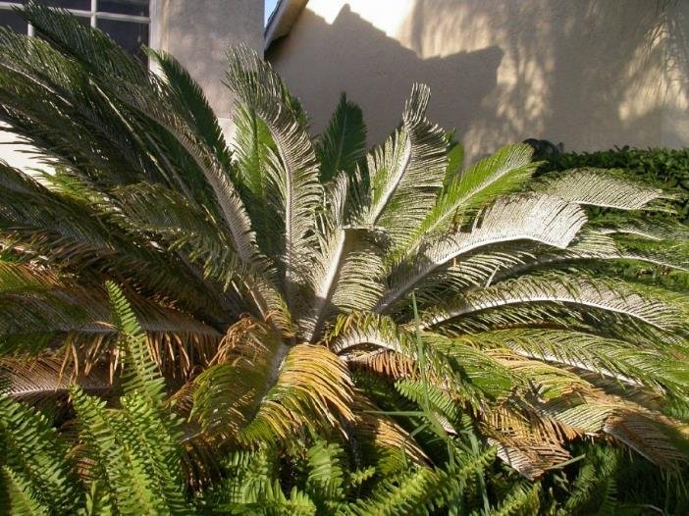
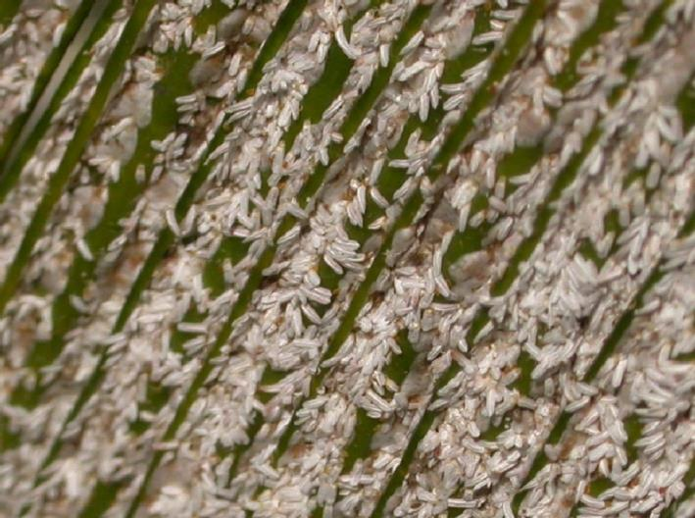


BIOLOGICAL CONTROL OF THE CYCAD AULACASPIS SCALE
Ronald D. Cave

Slide 2
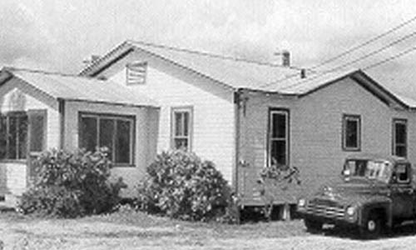
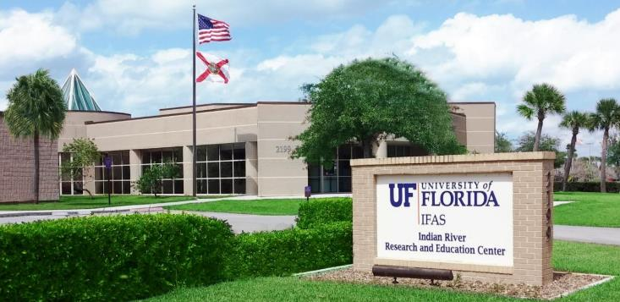
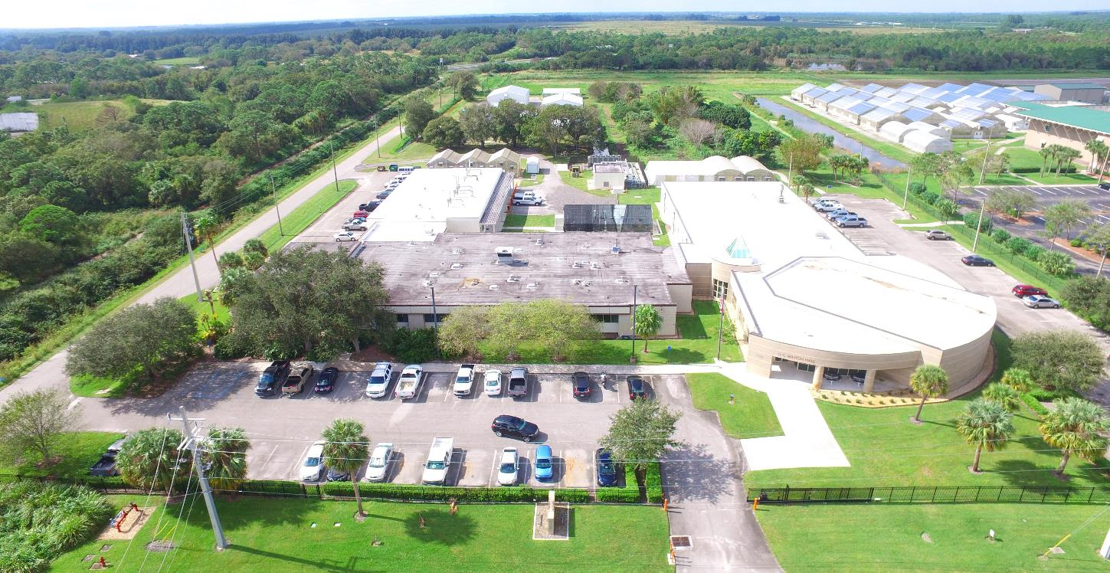
1947

Slide 3
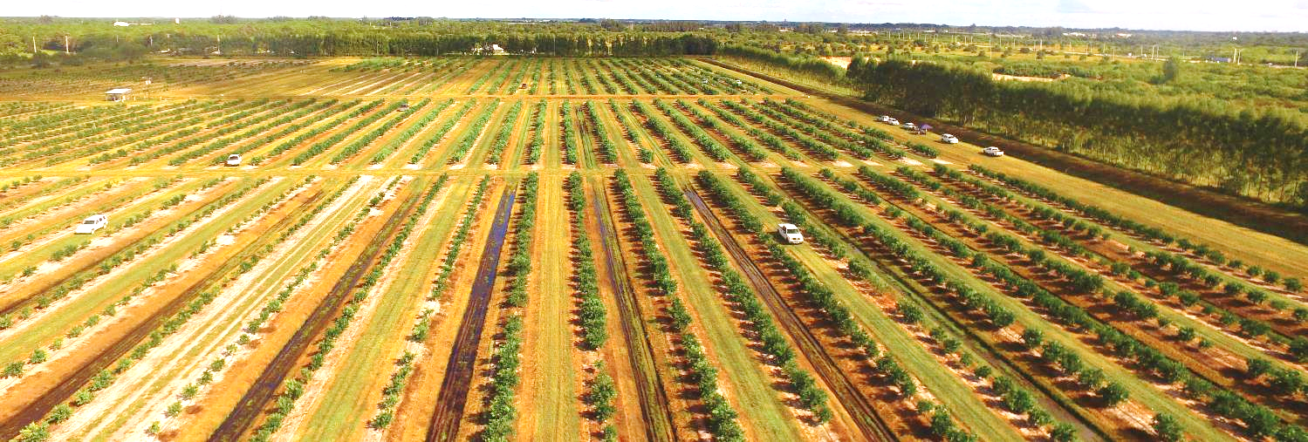
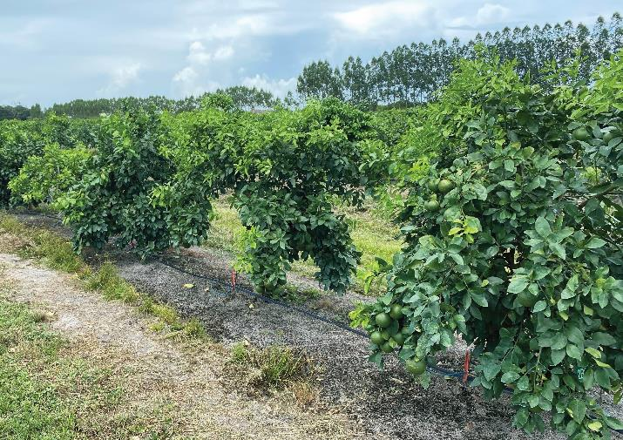
Citrus: Scion and Rootstock Trials
Nutritional therapies
Fertilization guidelines
Bactericides
Genomics of fungal pathogens
Early detection system for CLas
Oak mulch
Smart irrigation
Phosphorus management
Tolerant grapefruit varieties

Slide 4
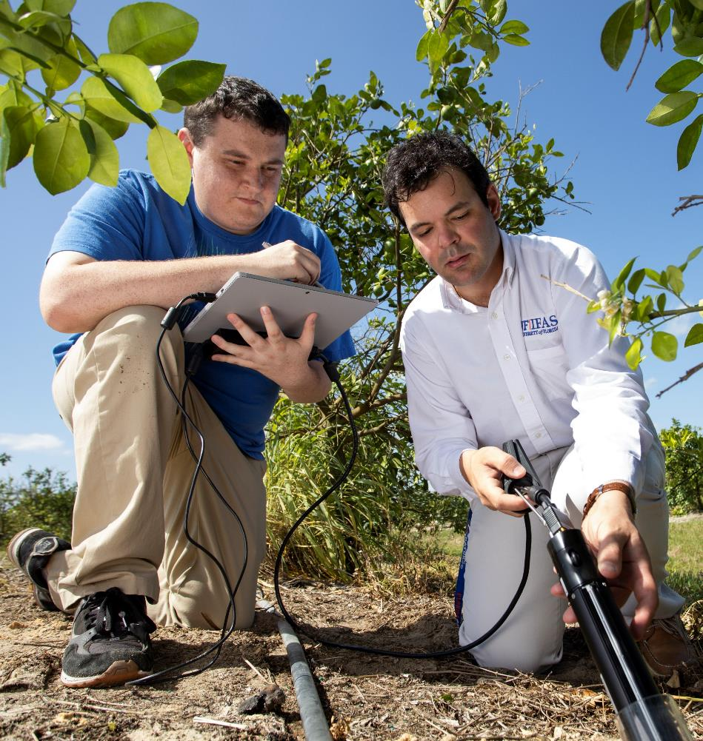
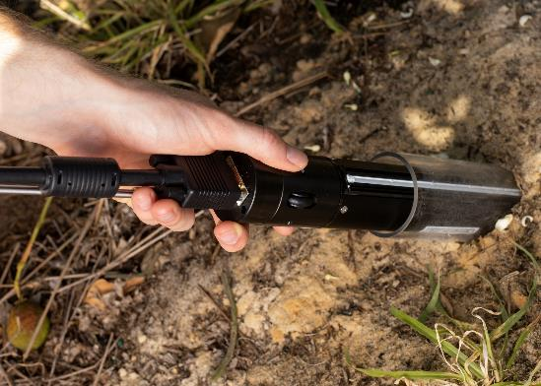
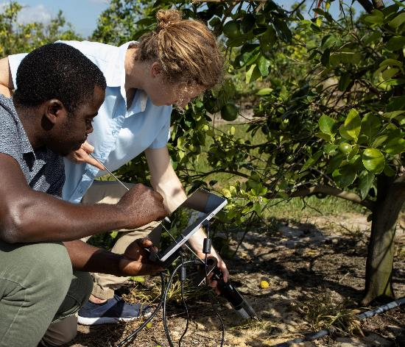
Rhizotrons: Belowground Imagery of Roots

Slide 5
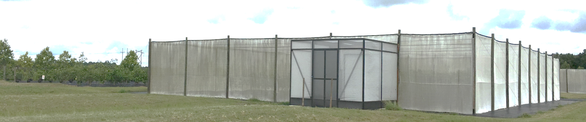
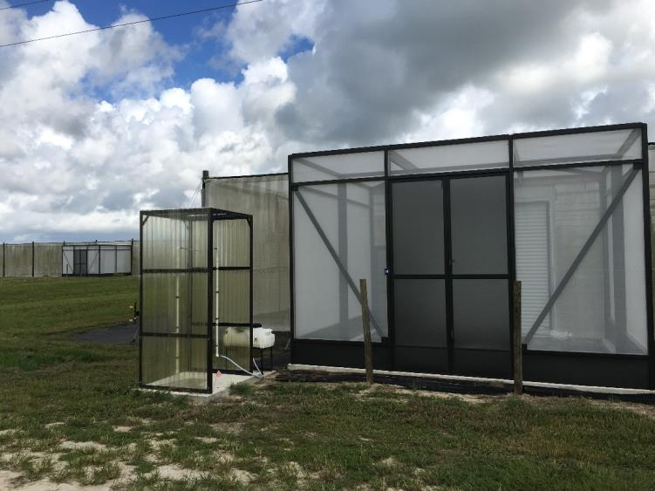
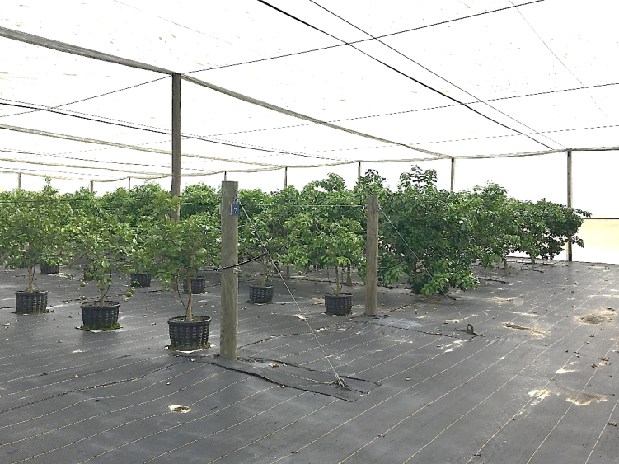
Citrus Under Protective Cover

Slide 6
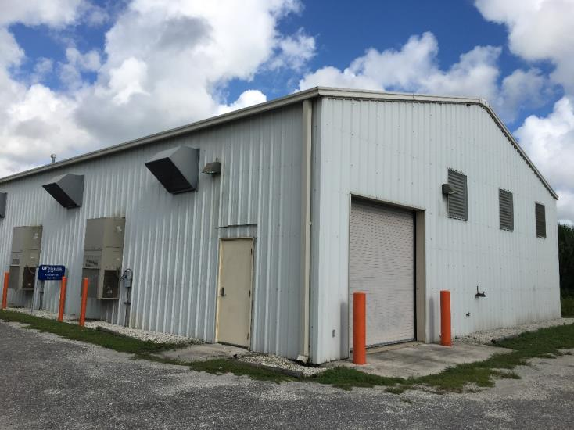
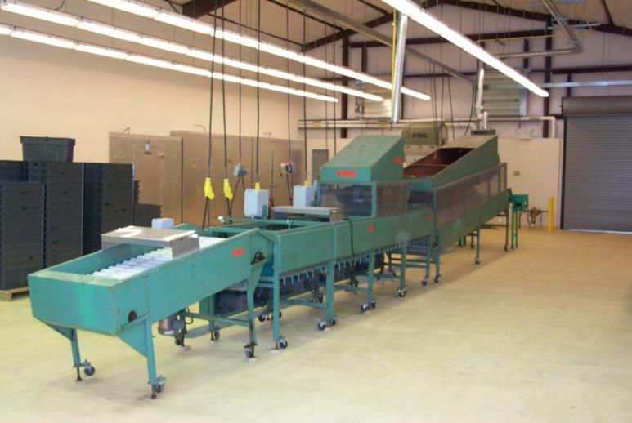
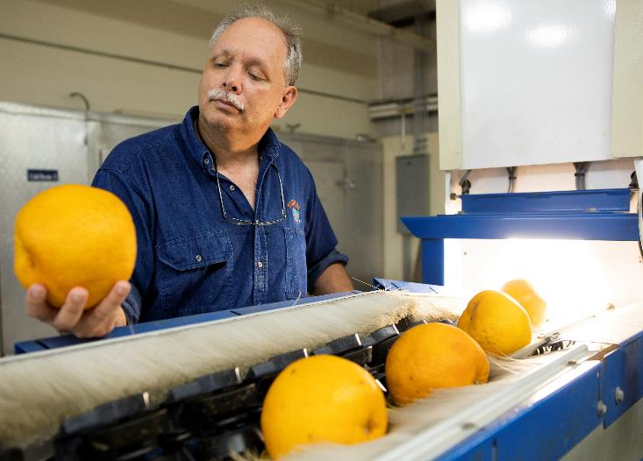
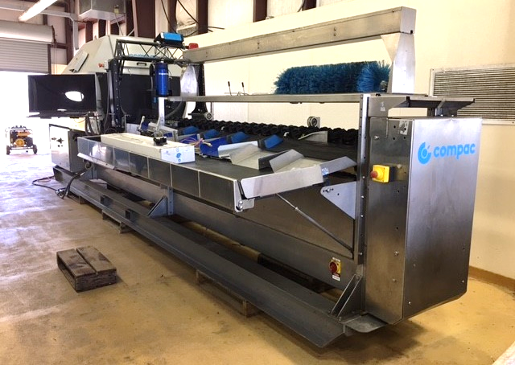
Postharvest Facility

Slide 7
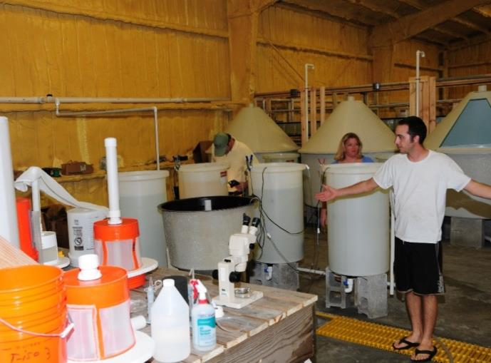
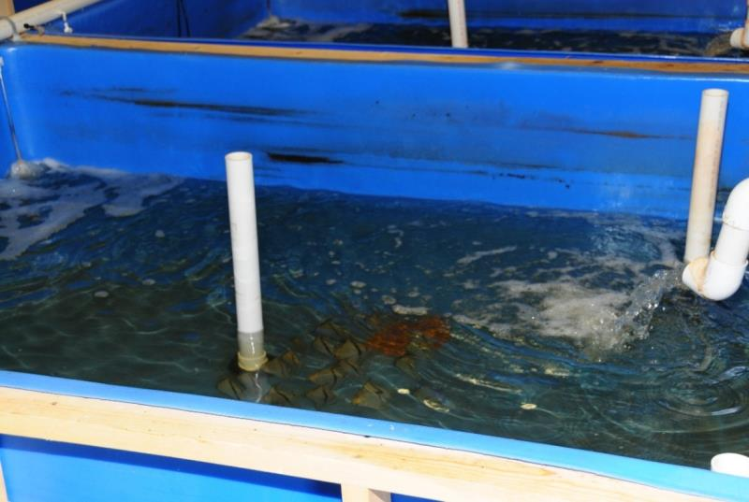
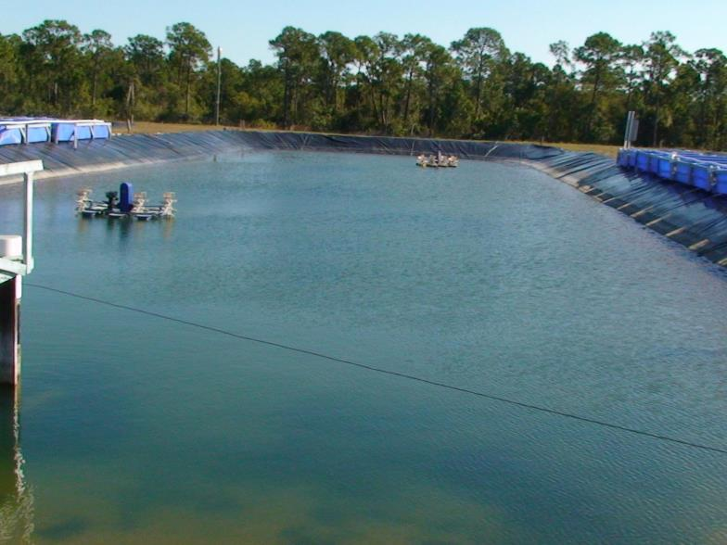
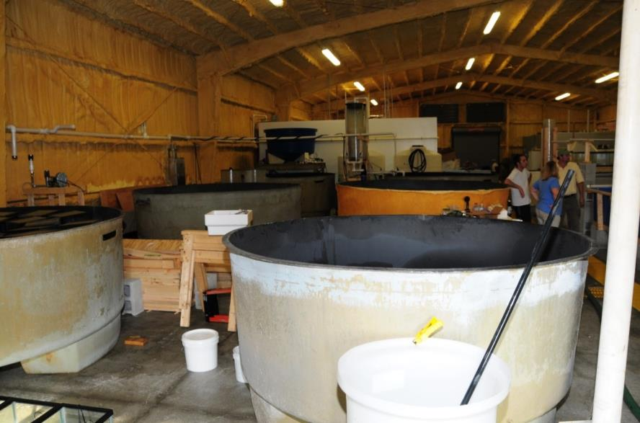
Aquaculture Research and Demonstration Facility

Slide 8
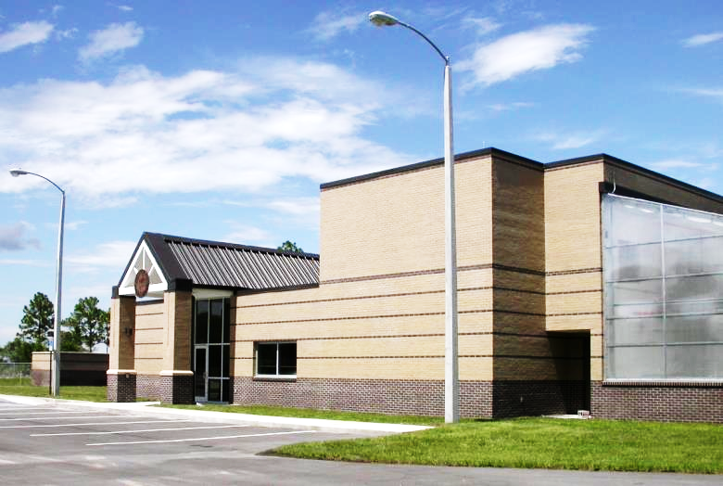
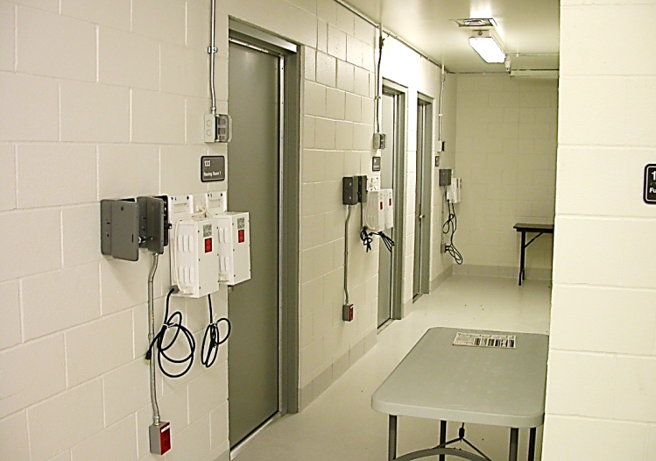
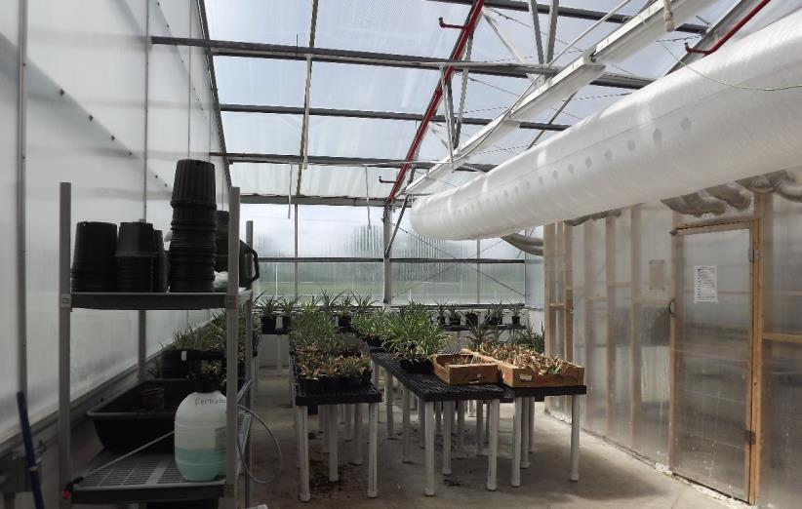
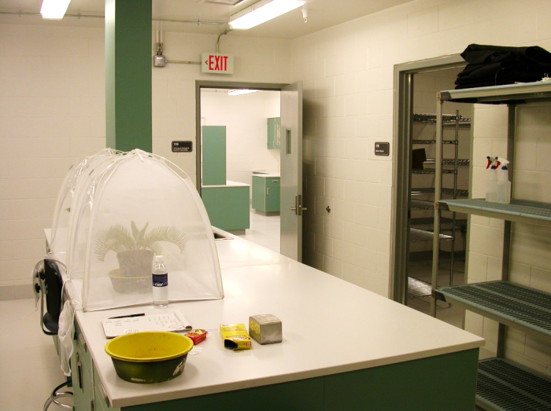
Hayslip Biological Control Research & Containment Laboratory

Slide 9
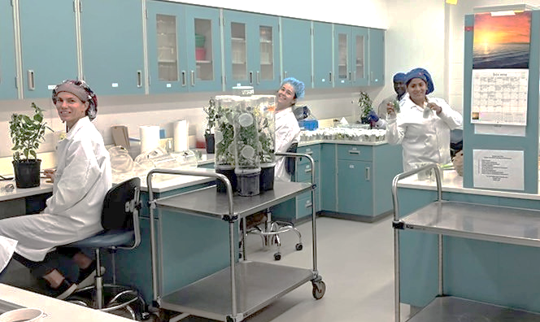
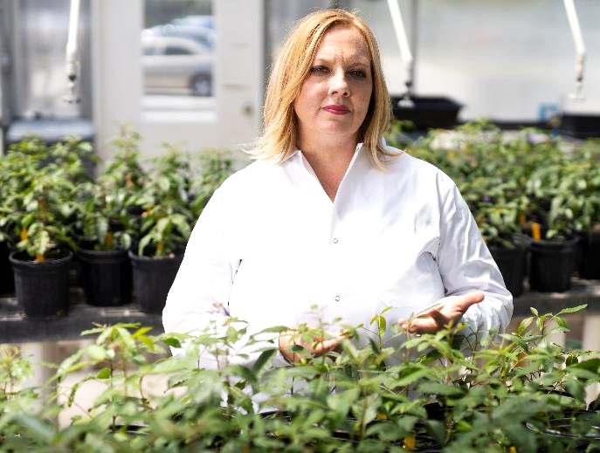
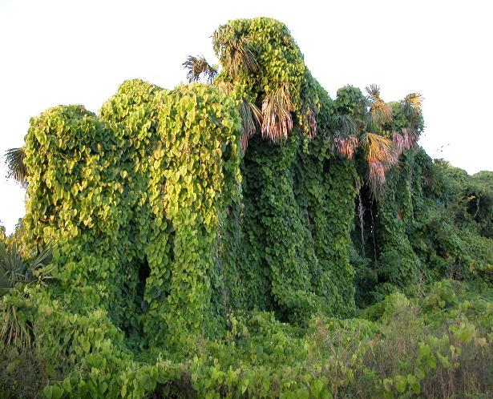
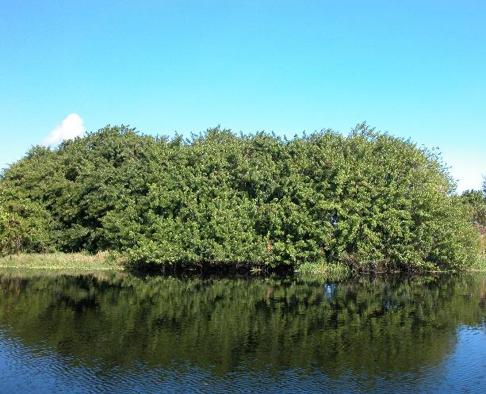
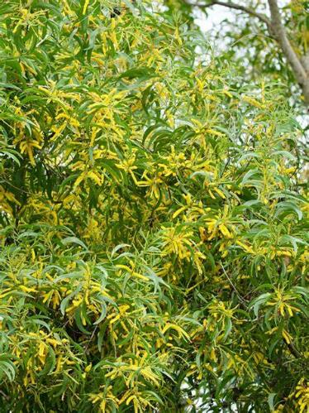
Biocontrol of Weeds
Photo by Lyle Buss, UF

Slide 10
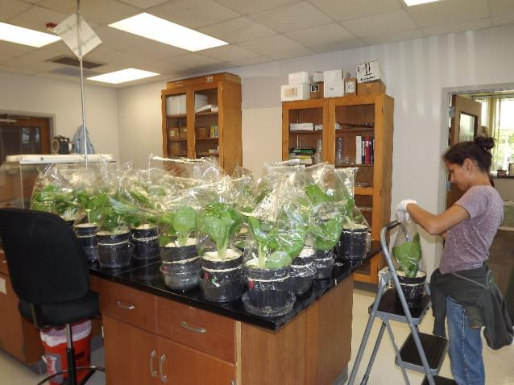
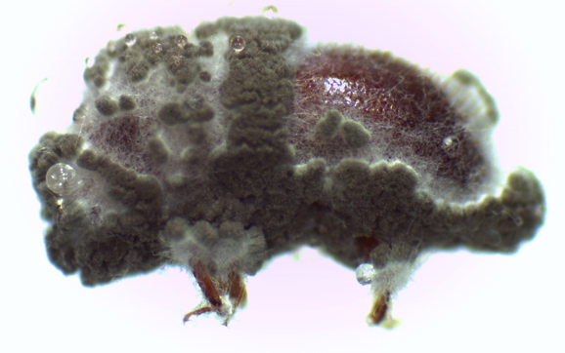
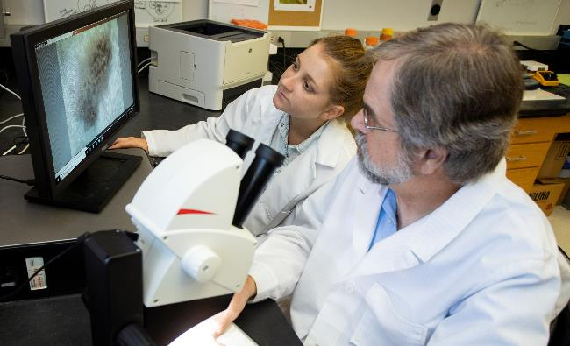
Entomopathogenic Fungus Research Laboratory

Slide 11
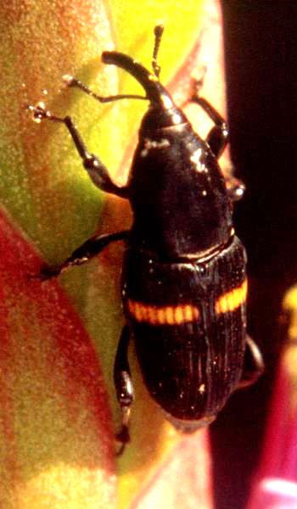
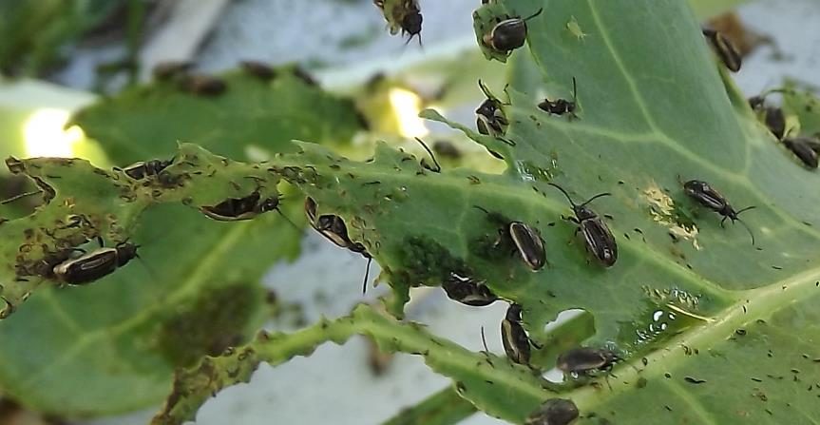
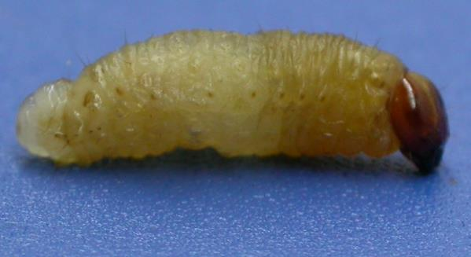
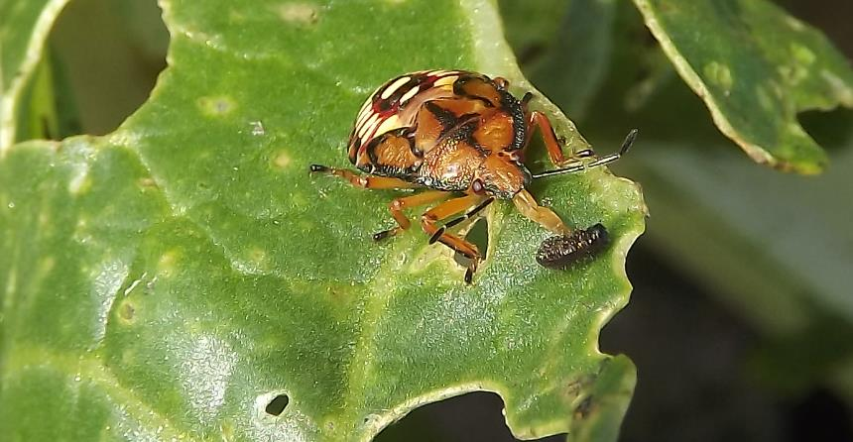
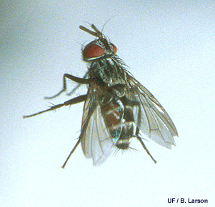
Biocontrol of Insects
Mexican bromeliad weevil
Yellowmargined leaf beetle
Photo by Lyle Buss, UF

Slide 12
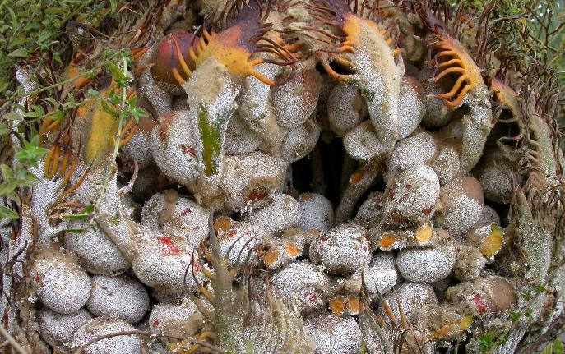
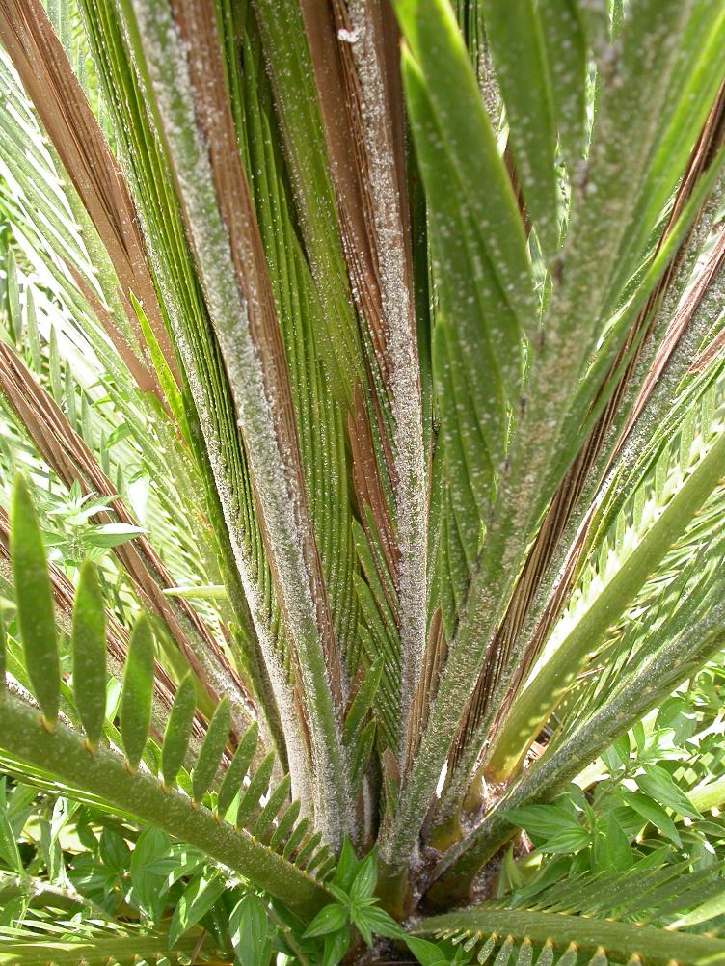
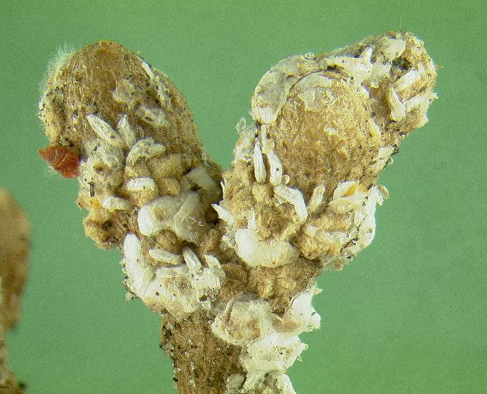
Cycad aulacaspis scale
Photo by Lyle Buss, UF

Slide 13
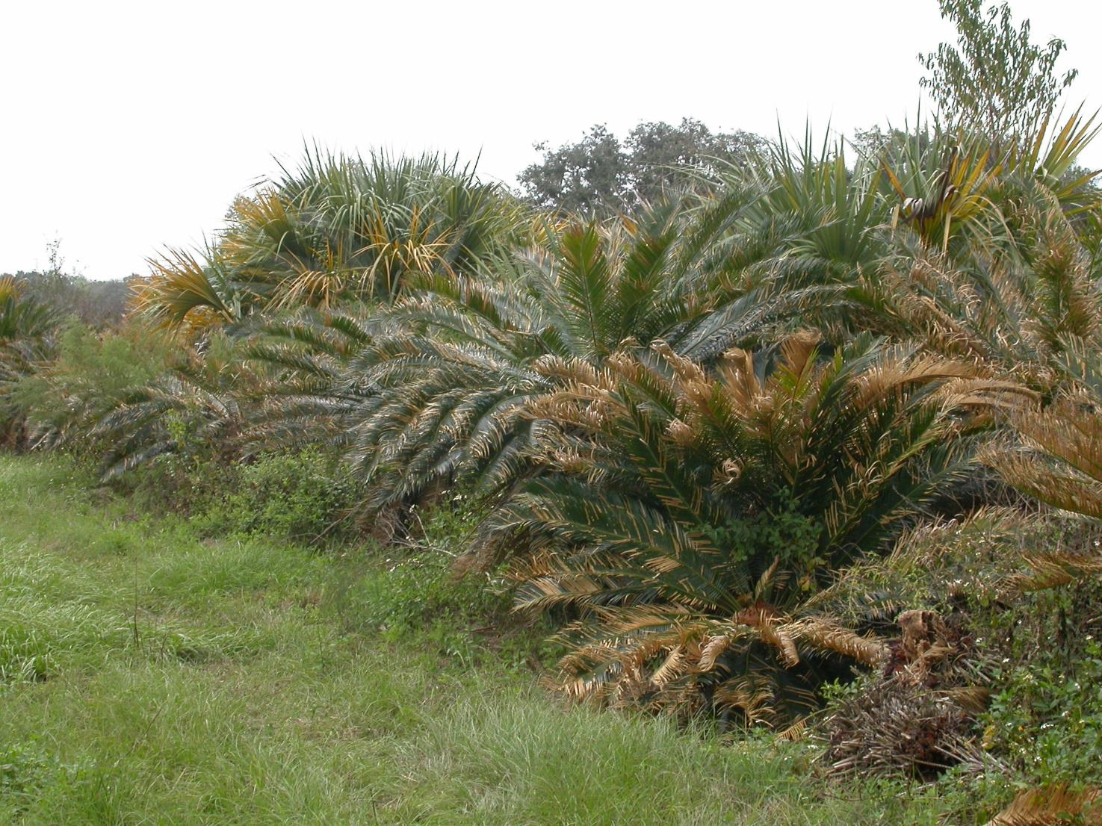
Photo by Lyle Buss, UF

Slide 14
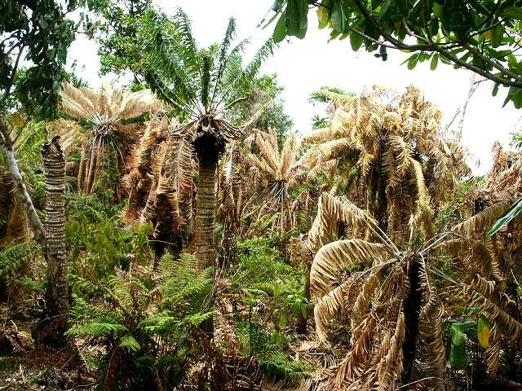
Photo by Lyle Buss, UF

Slide 15
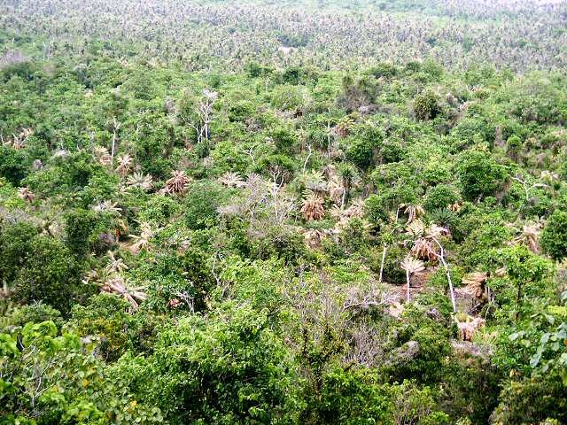
Photo by Lyle Buss, UF

Slide 16
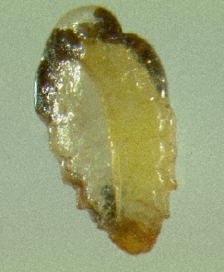
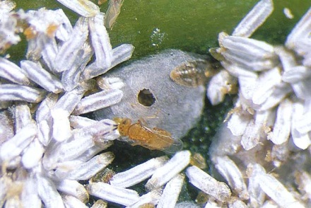
Coccobius fulvus
Native to Southeast Asia
Introduced into FL in 1998

Slide 17
Rates of parasitism on leaflets in Florida

Slide 18
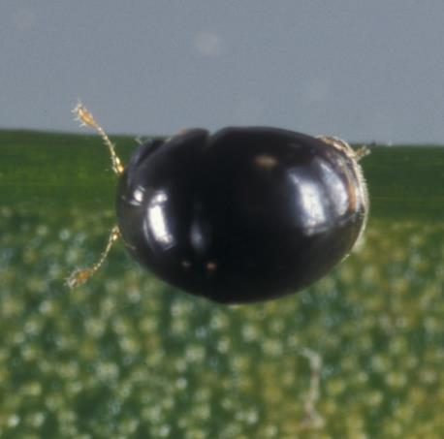
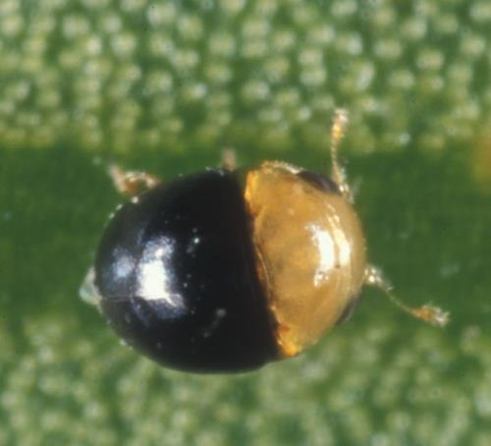
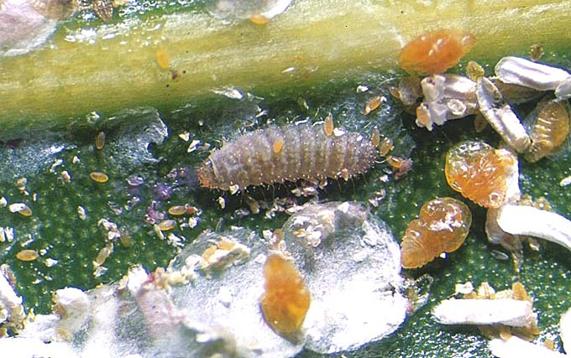
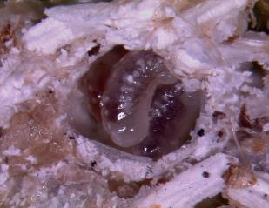
Cybocephalus nipponicus
♀
♂
Larvae and adults are predaceous on many species of armored scales
Larval-pupal parasitoid Aphanogmus albicoxalis

Slide 19


Rhyzobius lophanthae
♀
♂
Why is it not abundant in Florida?

Slide 20




FOREIGN EXPLORATION
VIETNAM – 2006, 2007

Slide 21




FOREIGN EXPLORATION
CHINA – 2006, 2009

Slide 22




FOREIGN EXPLORATION
THAILAND – 2007, 2009

Slide 23


FOREIGN EXPLORATION
Aprostocetus purpureus - generalist that attacks females scales - widespread, not too common in Asia
Photo: BA Bhuiya
Arrhenophagus chionaspidis - specialist on male armored scales only
- widespread and abundant in Asia
Natural History Museum, UK

Slide 24


Aphytis lingnanensis? Aphytis lepidosaphes?
cryptic species? biotypes?
- generalists that attack females scales - widespread for biocontrol in citrus

Slide 25



FOREIGN EXPLORATION
Phaenochilus kashaya
Voracious predator of armored scales

Slide 26




HABITAT OF P. kashaya IN THAILAND
Sakaerat Environmental Research Station
Sub Tao

Slide 27
COMPARATIVE DEVELOPMENTAL TIMES egg hatch-adult at 25° C
Aulacaspis yasumatsui 23 days
Coccobius fulvus 27 days
Cybocephalus nipponicus 32 days
Rhyzobius lophanthae 28 days
Phaenochilus kashaya 39 days

Slide 28
COMPARATIVE FECUNDITY
Aulacaspis yasumatsui ?? “1-10 daily, 50-150 total”
Coccobius fulvus 61 eggs at 25° C
Cybocephalus nipponicus 288 eggs at 22° C
Rhyzobius lophanthae 50 eggs at 24° C
Phaenochilus kashaya 339 eggs at 20° C

Slide 29
COMPARATIVE CONSUMPTION RATES at 25° C
Coccobius fulvus 61/adult female
Cybocephalus nipponicus 20/larval period
Rhyzobius lophanthae 75/larval period 2-3/adult day
!
Phaenochilus kashaya 380/larval period 29/ 5 adult days adult ♀♀ live 158 days

Slide 30

ENTOMOPATHOGENIC FUNGI
Cordyceps javanica
73-84% infection rate; reduced molting rate by 72%
Capable of infecting scales on leaves, trunk, crown, and in soil?
Field trials needed

Slide 31
ENTOMOPATHOGENIC NEMATODES, maybe?
Steinernema carpocapsae
Heterorhabditis bacteriophora
Heterorhabditis marelatus
Heterorhabditis indica
Parasitism by all 4 species, but low
Capable of killing scales on trunk, crown, soil?
Need to do lab and field trials again

Slide 32






FIVE AGAINST ONE
Jeffrey W. Lotz, FDACS, Bugwood.org
Natural History Museum, UK
Nat Vandenberg, USDA ARS SEL

Slide 33


SIX AGAINST ONE?
Jeffrey W. Lotz, FDACS, Bugwood.org
Nat Vandenberg, USDA ARS SEL

Slide 34


Photo by Lyle Buss, UF

Slide 35


Photo by Lyle Buss, UF

Slide 36


Scymnine lady beetle
Photo by Lyle Buss, UF

Slide 37
SEVEN AGAINST ONE?
Jeffrey W. Lotz, FDACS, Bugwood.org
Nat Vandenberg, USDA ARS SEL

